Slide 1
Woodworking Joints
GWW
8 March 2016

Slide 2
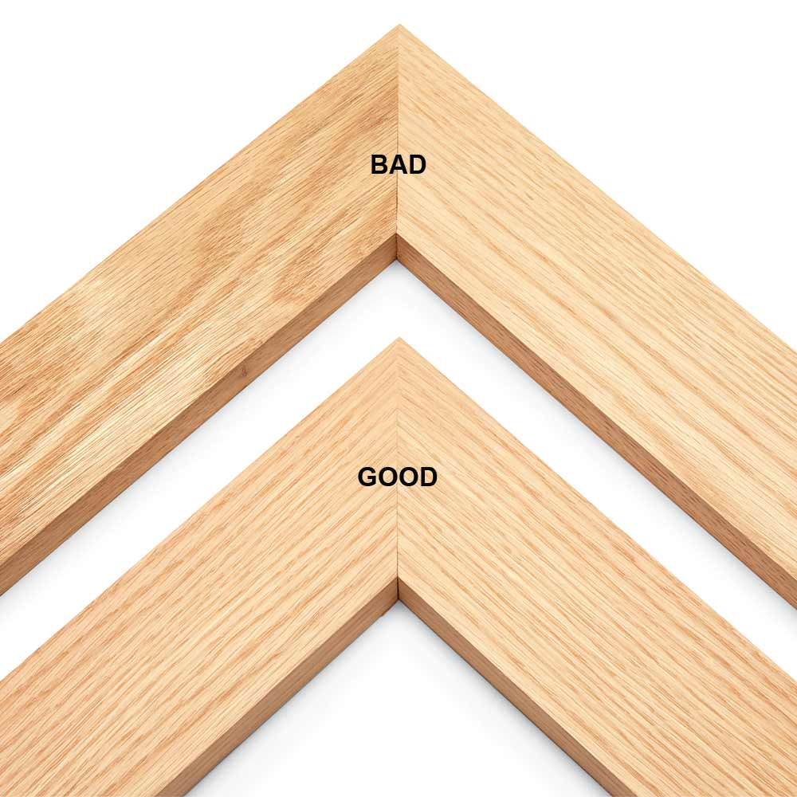

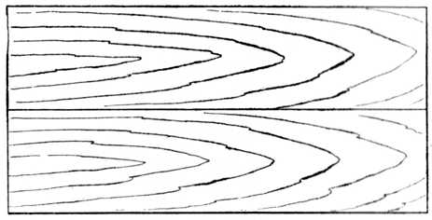
Butt Joints
Plain Butt
Mitred Butt

Slide 3
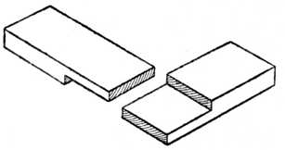
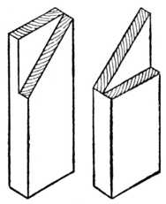
Halving (Half Lap) Joints
Corner Halving
Mitred Corner Halving

Slide 4
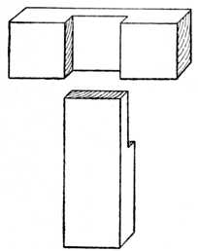
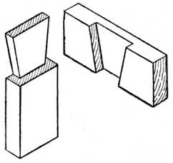
Halving Joints 2
T Halving
Dovetailed T Halving

Slide 5
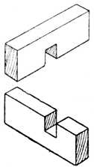
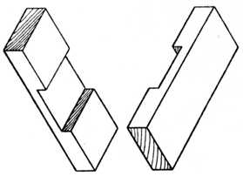
Halving Joints 3
Cross Halving
Edgeways Cross Halving

Slide 6
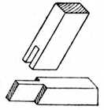
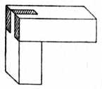
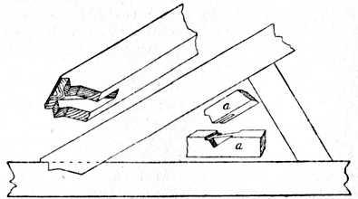
Bridle Joints
Simple corner bridle
Angled bridle

Slide 7
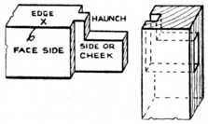
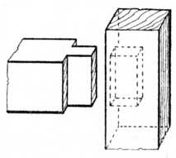
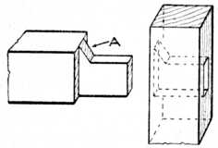
Mortise and Tenon
Stub Tenon
Haunched Tenon

Slide 8
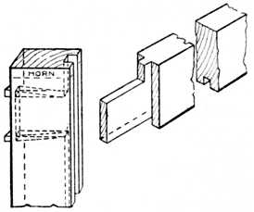
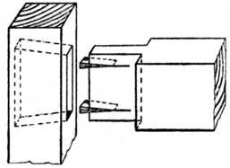
Mortise and Tenon 2
Wedged Through Tenon
Fox-wedged

Slide 9
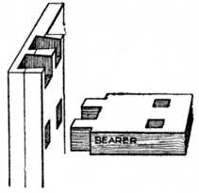
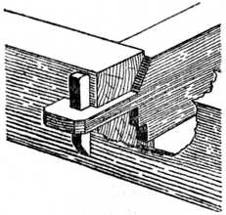
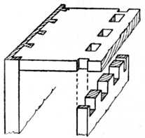
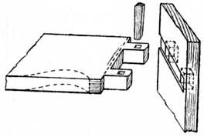
Mortise and Tenon 3
Twin/Multiple Tenons
Tusk Tenons

Slide 10
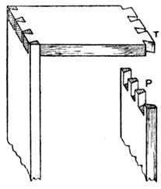
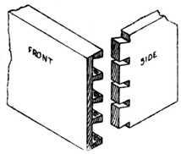
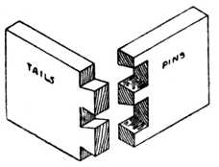
The Dovetail
Through Dovetail
Stopped Dovetail

Slide 11
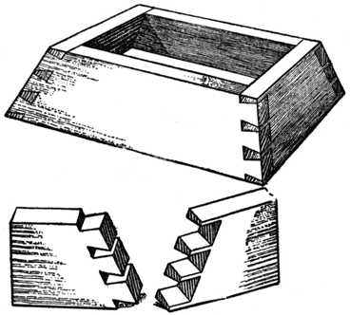
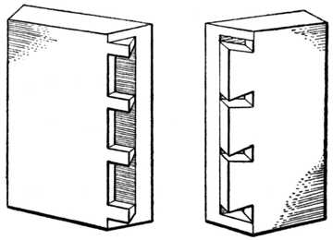
Wait, there’s more…
Secret Mitre Dovetail (specially for masochists)
Compound angled….

Slide 12
But that’s for another day…
Thanks to the Project Gutenberg
https://www.gutenberg.org/files/21531/21531-h/21531-h.htm

